Slide 1
My Hometown
Lusine Arakelyan
American University of Armenia
June 8, 2025

Slide 2
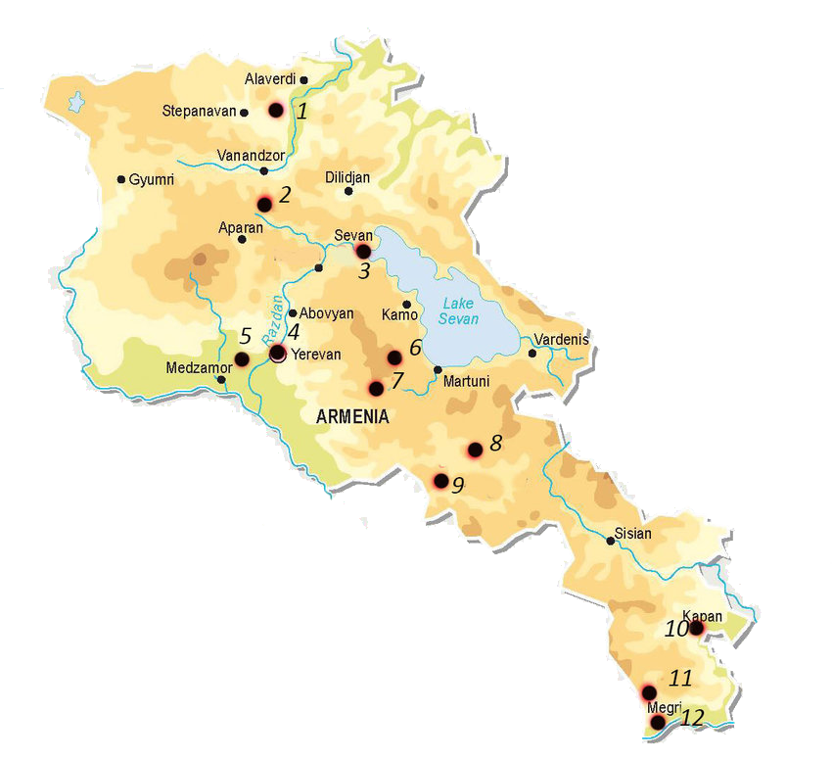
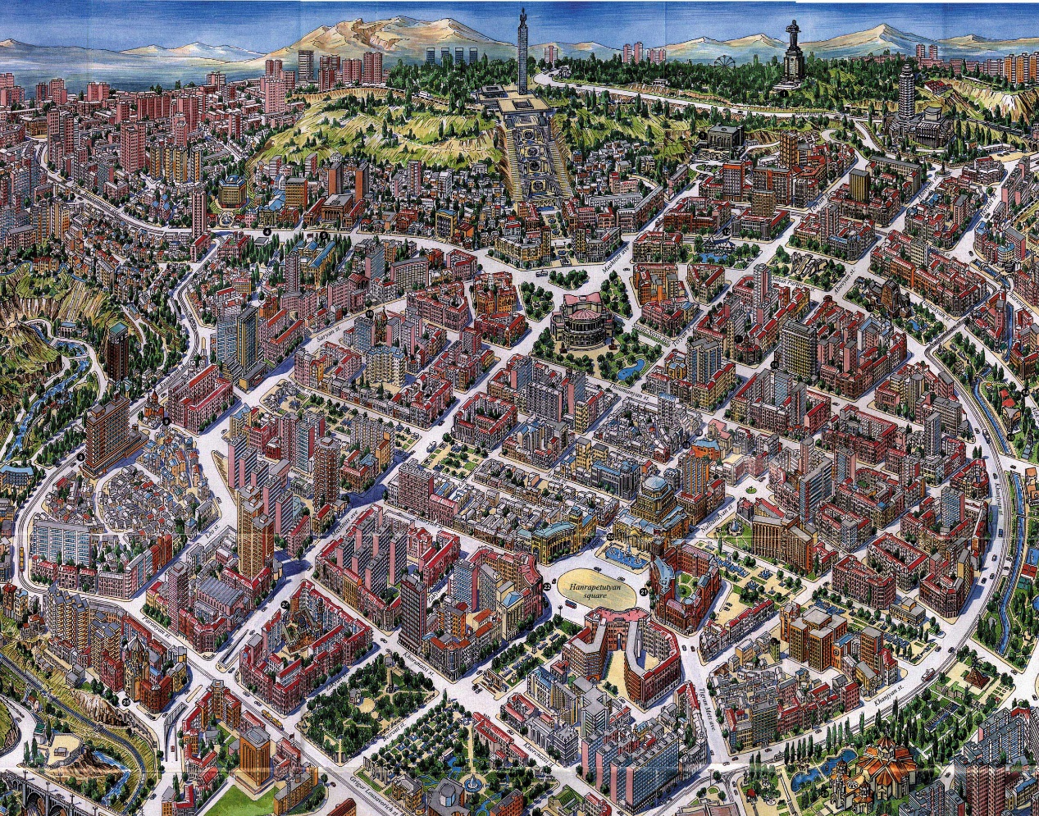
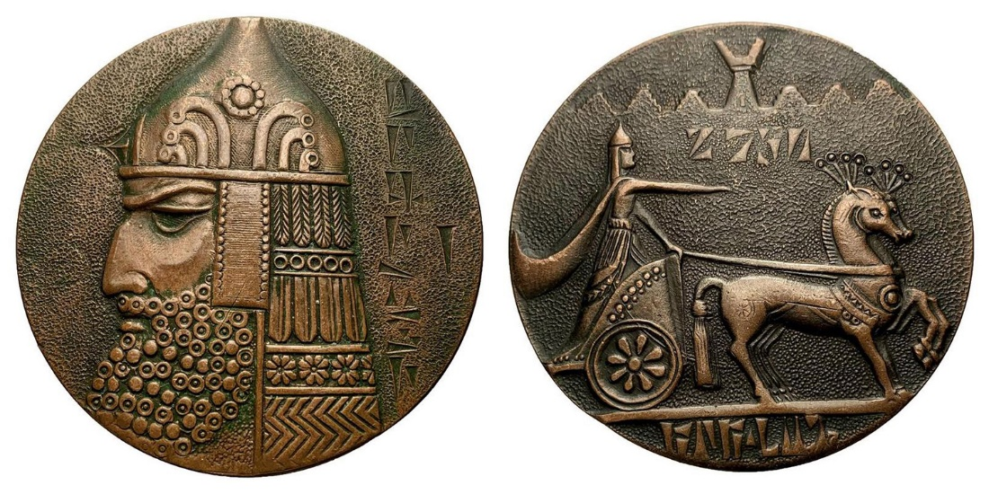
1. Story
My hometown is Yerevan.
Yerevan is the capital of Armenia.
It is 2807 years old. It was built by king Argishthi in 782 BC.

Slide 3
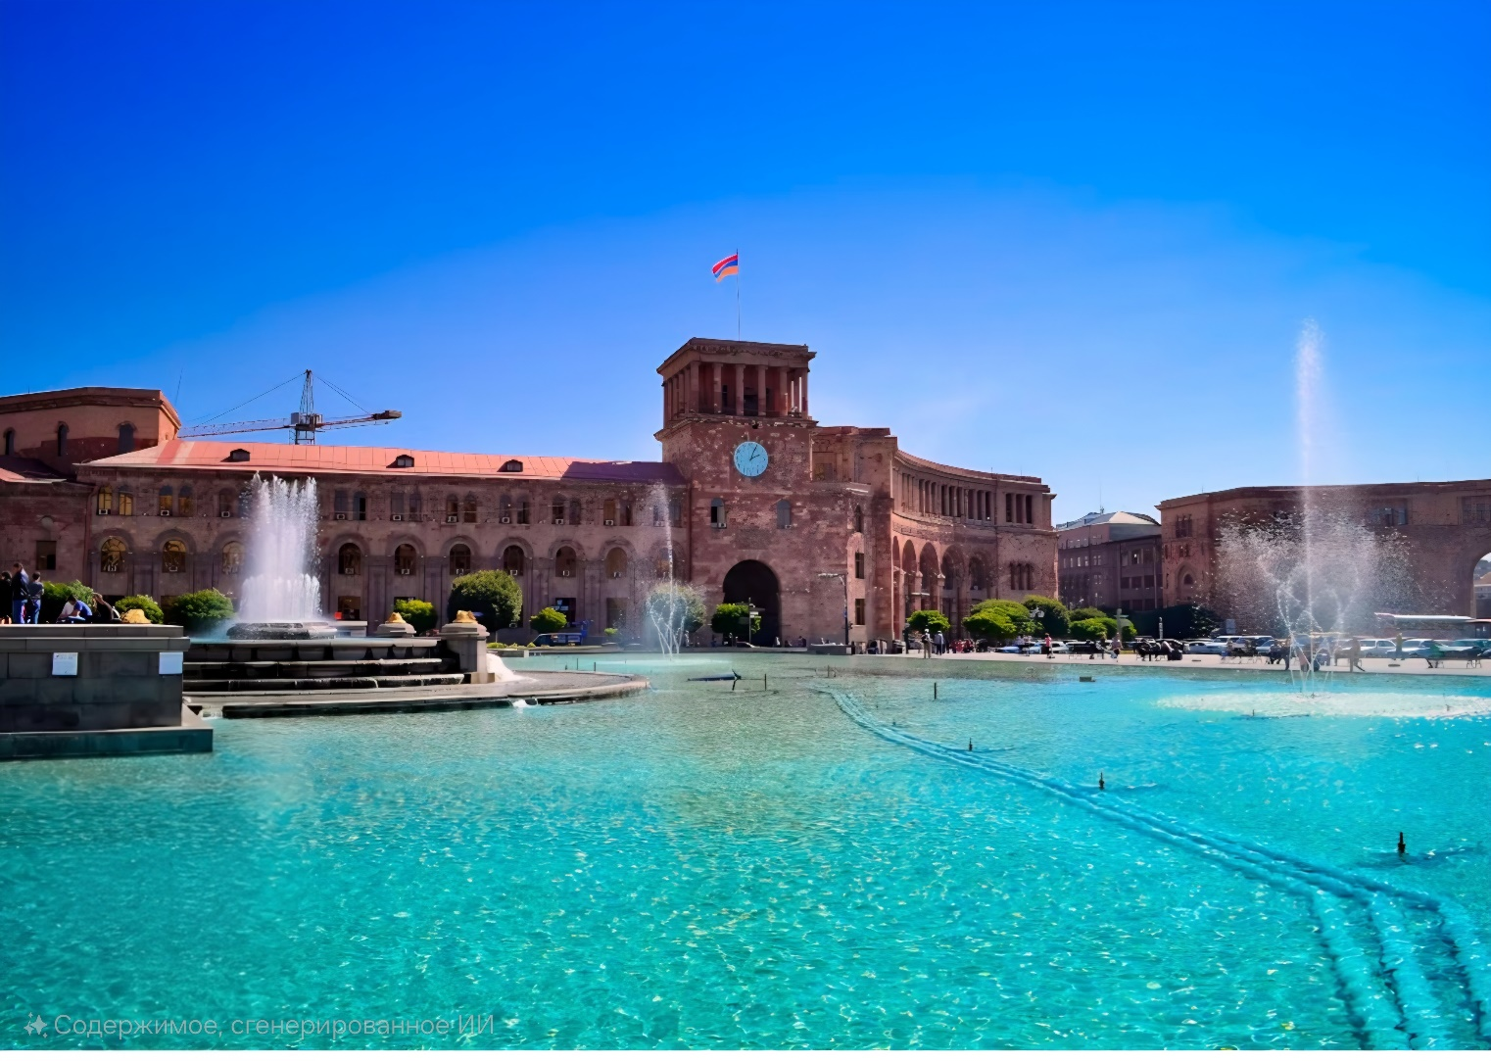
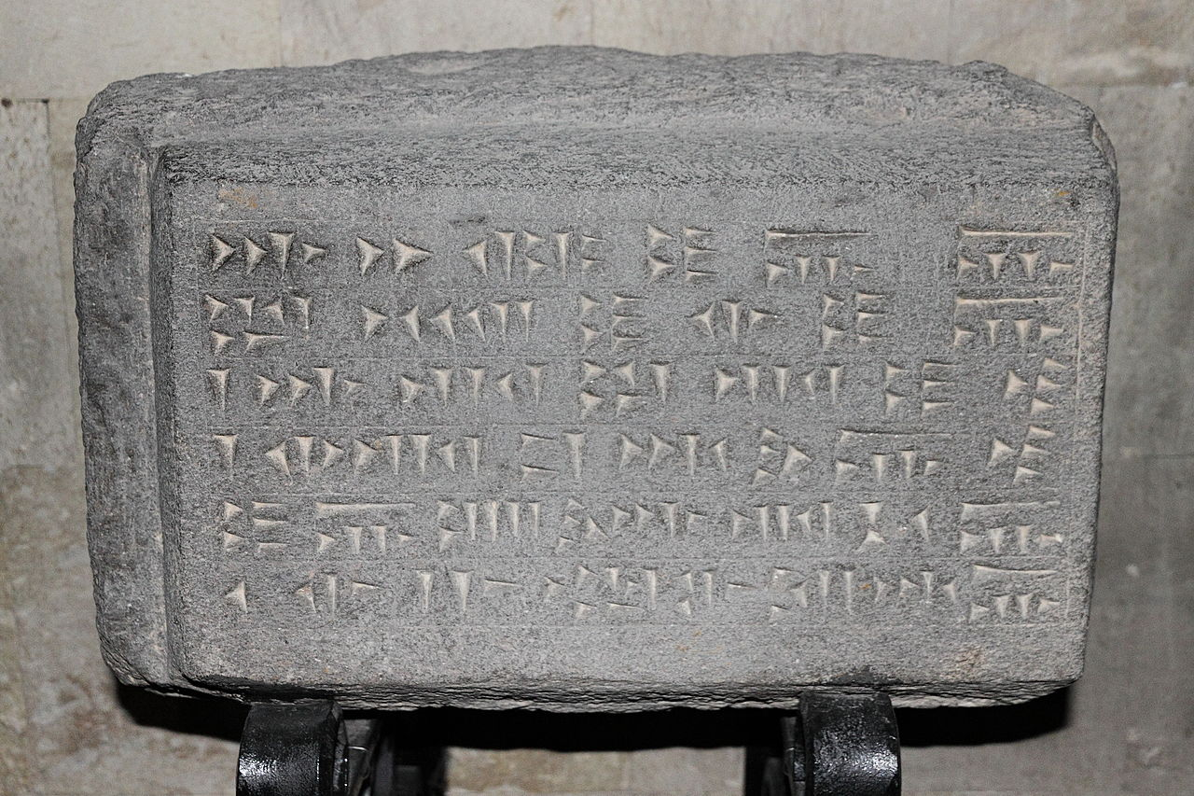
1. Story
Yerevan has a passport, which is kept in the history Museum of Armenia.
Yerevan is often called “The pink city” because many buildings are made from pink stone called tuff.

Slide 4
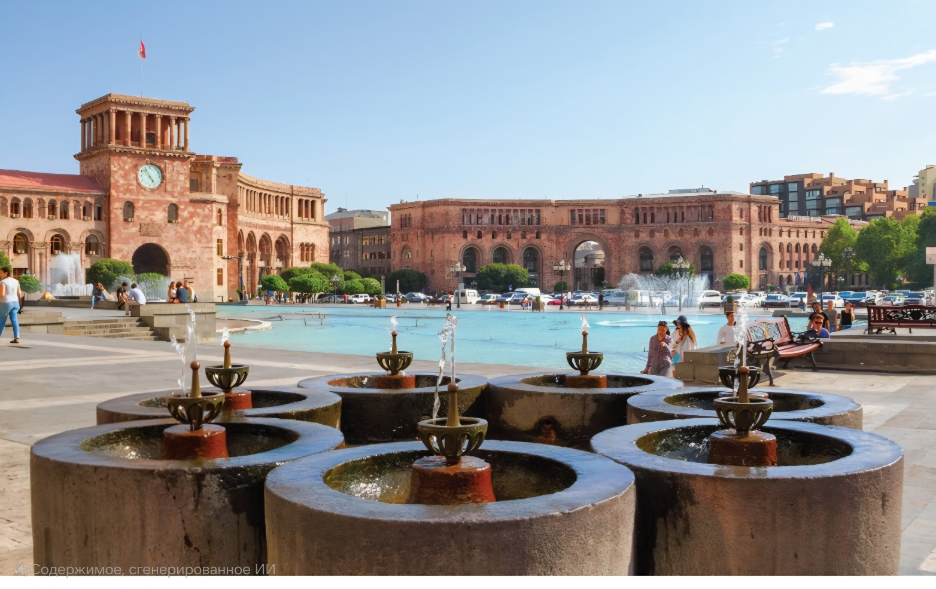
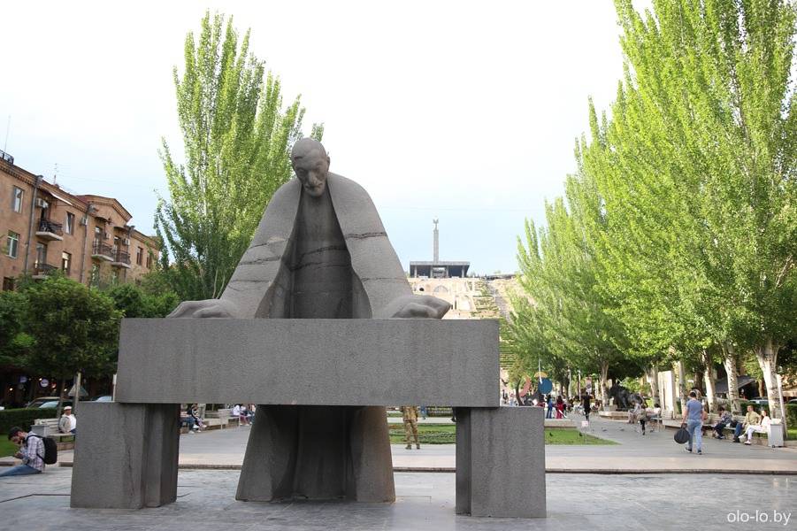
1. Story
The beautiful and stylish buildings of Yerevan were designed by Alexander Tamanyan.
There are many water fountains in the city of Yerevan.

Slide 5
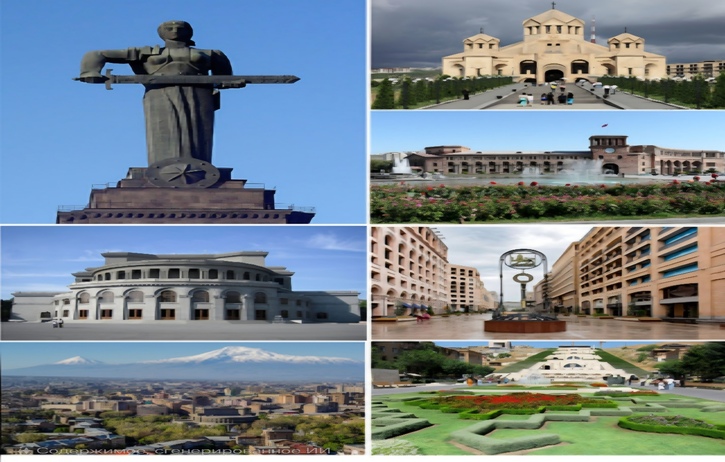
1. Story
Yerevan is as old as it is modern.

Slide 6
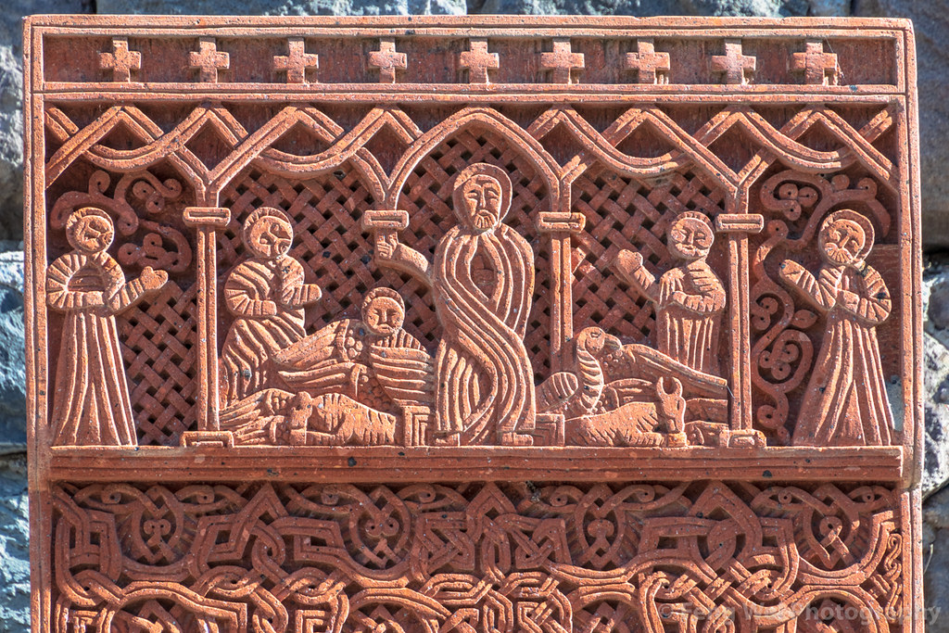
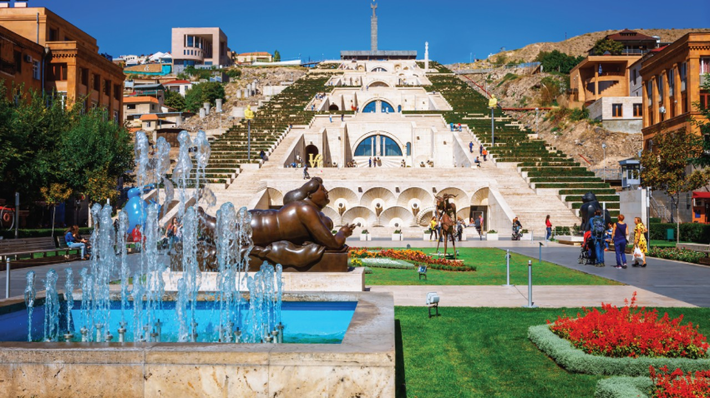
1. Story
Yerevan is an open-air museum.
In the streets, you can see unique khachkars that exist only in Armenia.

Slide 7
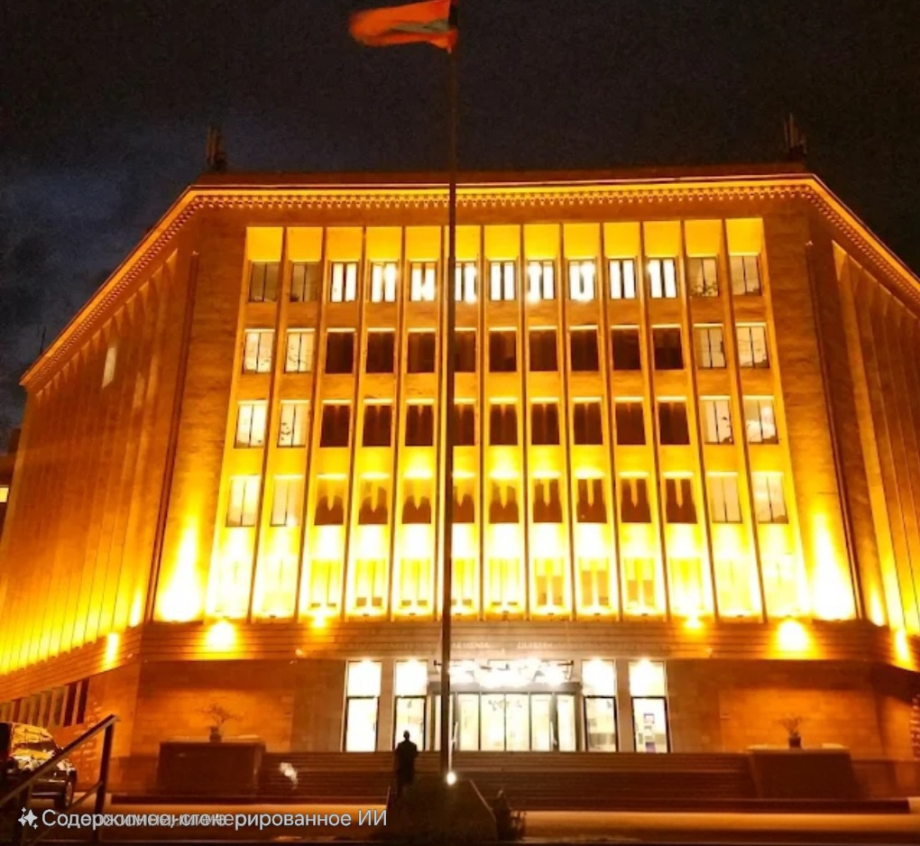
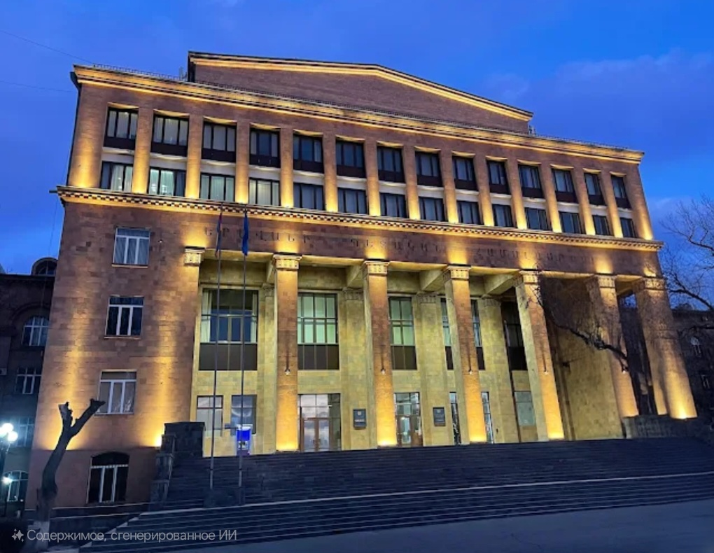
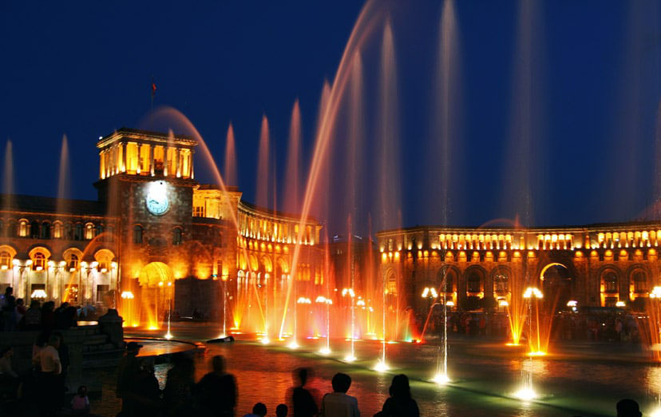
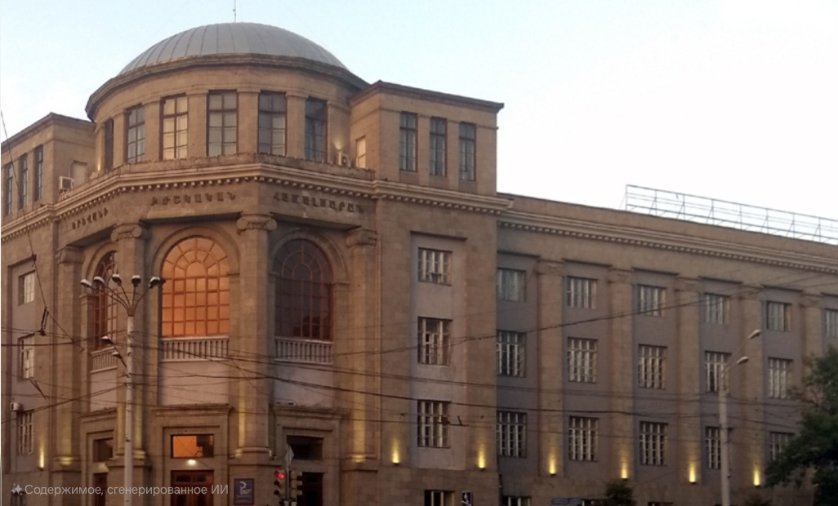
1. Story
There you can find the “Singing fountains”.
Yerevan is a student city. There are many universities here
One of those universities is the American University of Armenia (AUA).

Slide 8
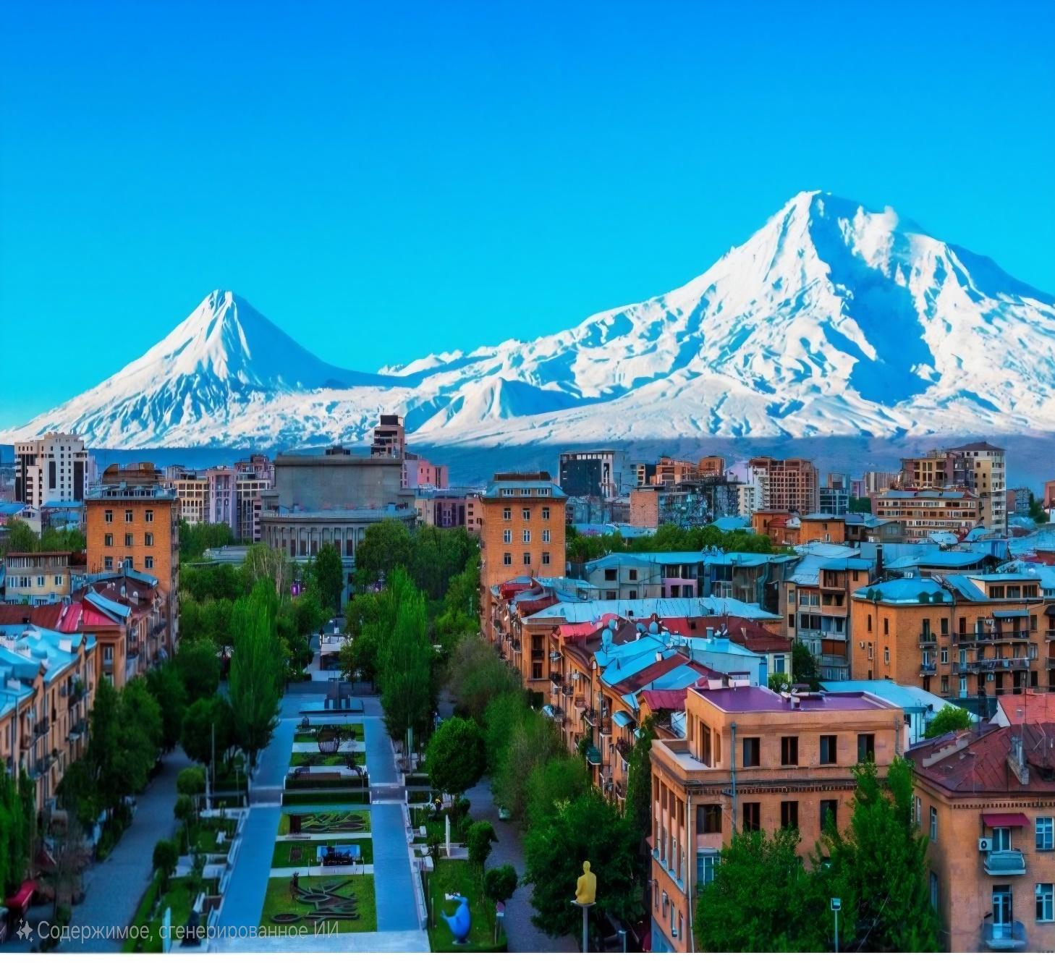
1. Story
I am very happy to study at this university and I full lucky to live in my hometown, Yerevan

